Slide 1
F70/71
Mechanic and Vacuum
Franka Neumann & Nick Striebel
Notes:
Hello everyone, today we will present you the experiment F70/71 Mechanic and Vacuum. We did it online in November, so some parts might be a bit more theoretical.

Slide 2
Agenda
Theoretical basics
Experimental setup
Evaluation of the measurements
Discussion
Notes:
So, this is the plan for today:
I will start with the theoretical basics,
Afterwards Franka will present you the experimental setup
Before I will continue with the evaluation of the results
At the end Franka will have a brief discussion and sum everything up
After the presentation there should be enough time for questions, but feel free to ask any questions directly during the presentation.

Slide 3
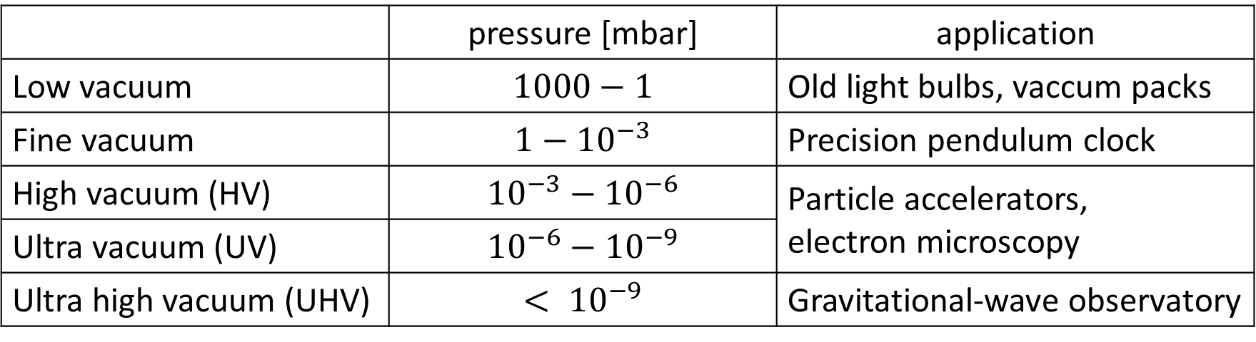
Vacuum
Theoretical basics
 | pressure [mbar] | application
Low vacuum | $$1000−1$$ | Old light bulbs, vaccum packs
Fine vacuum | $$1−{10}^{−3}$$ | Precision pendulum clock
High vacuum (HV) | $${10}^{−3}−{10}^{−6}$$ | Particle accelerators, electron microscopy
Ultra vacuum (UV) | $${10}^{−6}−{10}^{−9}$$
Ultra high vacuum (UHV) | $$< {10}^{−9}$$ | Gravitational-wave observatory
Notes:
So, let me start with some theoretical basics:
One distinguishes between 5 pressure areas:
Low vacuum: old light bulbs, vacuum packs or for example the intake pressure of an otto motor
Fine vacuum: modern precision pendulum clocks
HV and UV: most experiments with atoms/small particles (for example: particle accelorators, electron microscopy)
UHV: needed for gravitational wave observatory, simulation of outer space

Slide 4
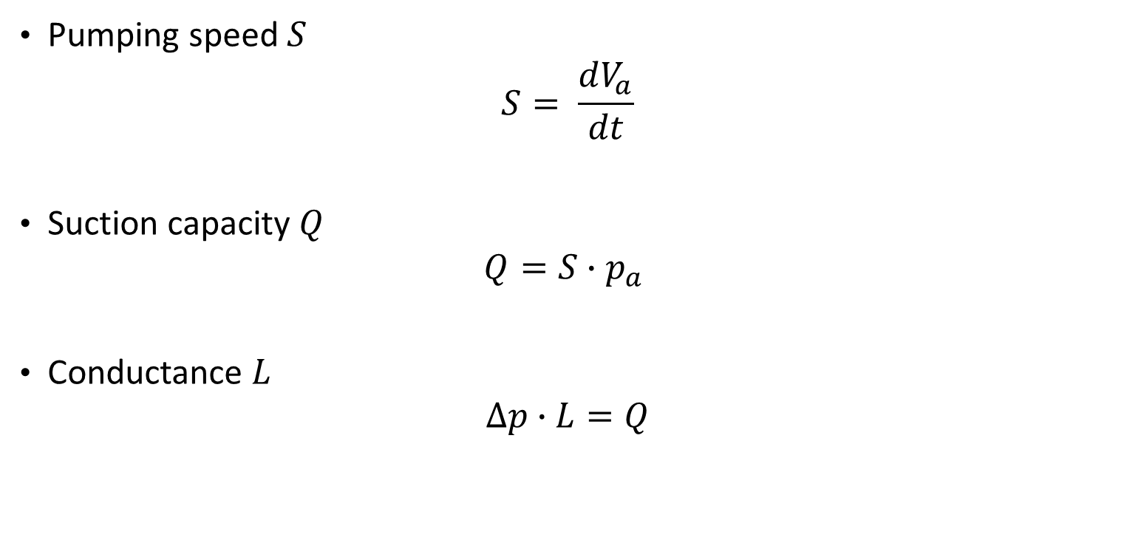
Important parameters
Theoretical basics
Pumping speed $S$
$$S= \frac{dV_{a}}{dt}$$
Suction capacity $Q$
$$Q=S∙p_{a}$$
Conductance $L$
$$∆p∙L=Q$$
Notes:
There are manly 3 important parameters in vacuum technology:
The first 2 ones are regarding the pumps:
Pumping speed S:
The volume of gas pumped per time at a specific pressure p
The suction capacity Q:
Is the pumping speed times the pressure: ➔ the total gas pumped
The third one is the conductance of connector:
The conductance L:
Parameter how high or low the resistance of a connector (for example tube or aperture) is
The conductance is the inverse of the resistance ➔ means one should reach for high conductance to reduce the pressure different on the ends of the connector

Slide 5
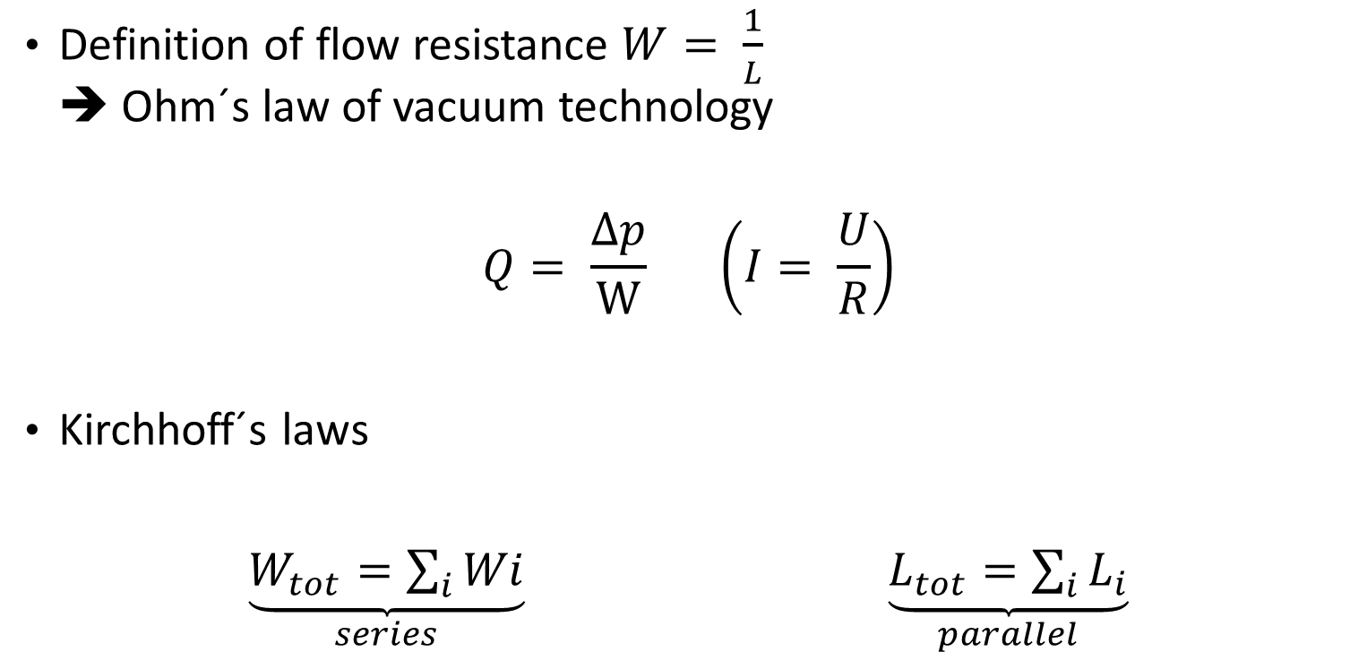
Conductance
Theoretical basics
Definition of flow resistance $W= \frac{1}{L}$ ➔ Ohm´s law of vacuum technology
$$Q= \frac{Δp}{W} \left(I= \frac{U}{R}\right)$$
Kirchhoff´s laws
$\underset{series}{\underbrace{W_{tot}=\sum_{i}{Wi}}} \underset{parallel}{\underbrace{L_{tot}=\sum_{i}{L_{i}}}}$
Notes:
- If one defines the resistance as the inverse of the conductance one can calculate with Ohms and Kirchhoffs laws of vacuum technology
The suction capacity is the pressure difference divided by the resistance
Using multiple connectors, one get the total resistance of a series connection by taking the sum over the single resistances
For parallel connectors one get the total conductance by taking the sum over the single conductances

Slide 6
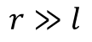
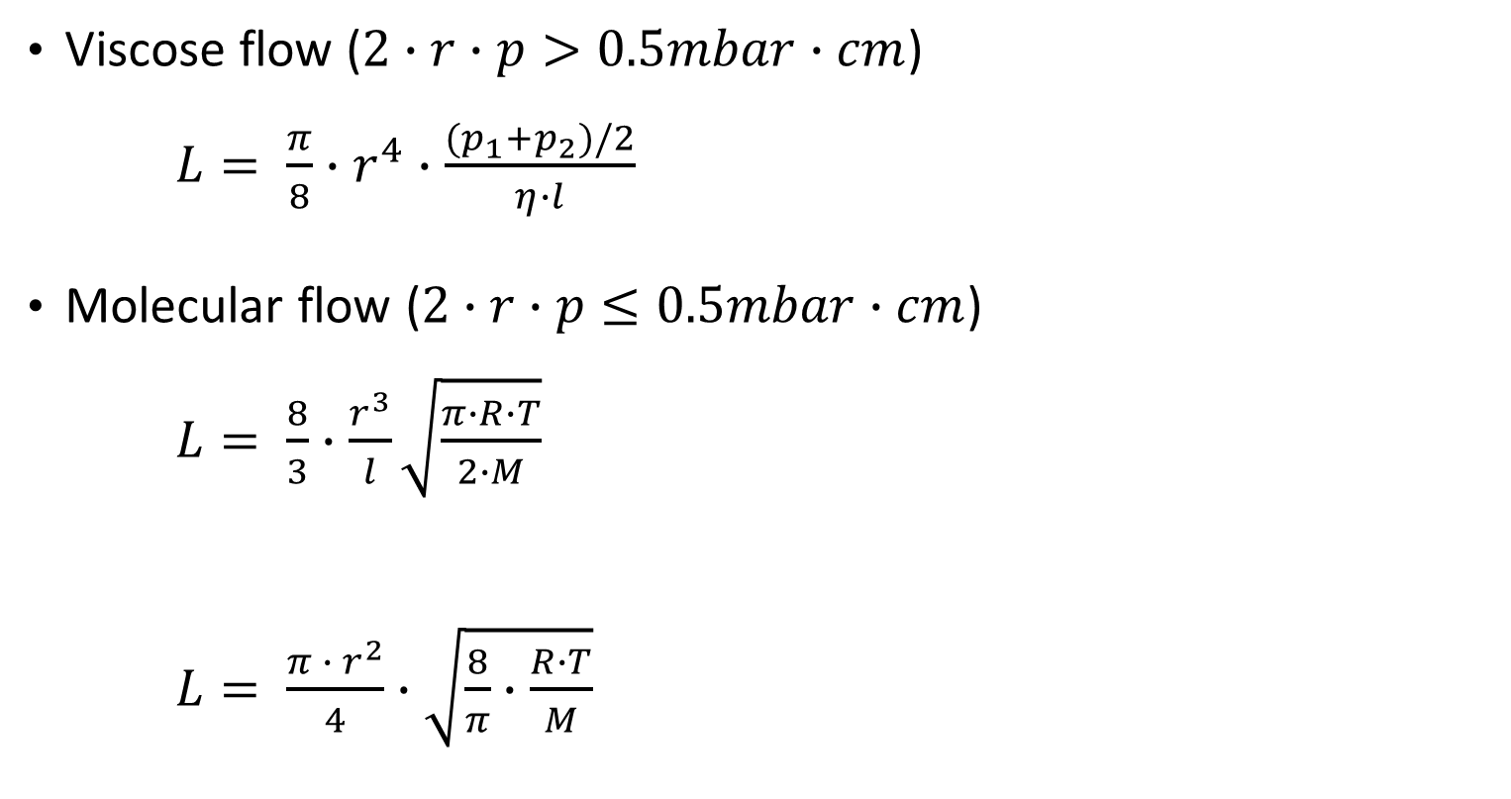
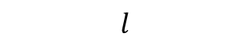
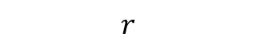
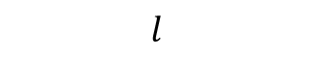
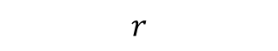
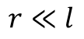
Conductance of tube and aperture
Theoretical basics
$$r$$
Viscose flow ($2∙r∙p>0.5mbar∙cm$) $L= \frac{π}{8}∙r^{4}∙\frac{{(p}_{1}+p_{2})/2}{η∙l}$
Molecular flow ($2∙r∙p≤0.5mbar∙cm$) $L= \frac{8}{3}∙\frac{r^{3}}{l}\sqrt{\frac{π∙R∙T}{2∙M}}$
$L= \frac{π ∙ r^{2}}{4}∙\sqrt{\frac{8}{π}∙\frac{R∙T}{M}}$
tube
$$l$$
$$r≪l$$
$$r$$
$$l$$
aperture
$$r≫l$$
Notes:
One distinguishes between two types of connectors:
Tubes: the radius is smaller than the length of the tube
Apertures: the length is very small compared to the radius
For tubes: two cases:
viscose flow (mean free path of the gas particles is much smaller than the diameter of the tube)
Molecular flow (mean free path is much bigger than the diameter)
Between: mean free path has the same scale as the diameter of the tube: Knudsen flow: nearly no intern interaction between the gas particles
Formulas not so important here
but r is the radius, l the length, p_1 and p_2 the pressures on the ends of the tubes and eta the viscosity of the gas
Molecular flow: the square root equals the harmonic mean of the velocity of the gas particles
Capital R is the gas constant, T the temperature, M the molecular mass
Aperture: if one ignores the length of the connector one gets the formula one can see her:
The square root is the mean particle velocity
Pi times r two the power of 2 is the cross-section area of a circular aperture
KLICK
What you can remember from these formulas is that:
The radius of the connector occurs with the power of 2,3 or 4 ➔ The radius should be as large as possible

Slide 7
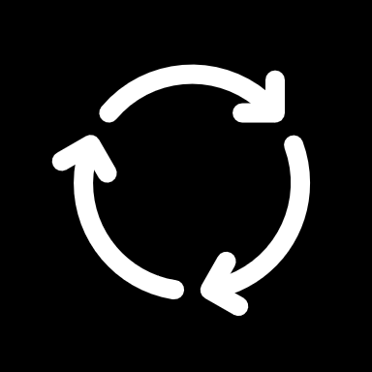
Vacuum pumps
Theoretical basics
Displacement pumps:
Piston pump
Rotary vane pump
Roots pump (two rotors)
Propellant pump
Molecular pump
Sorption pump
Cryopump
Combinations ➔ hybrid pumps
Notes:
5 major categories of pumps:
Displacement pumps (or often called mechanical pumps): principle: suction, closing, compression, ejection
KLICK
piston pump:
looks like an otto motor
final pressure approx. 5mbar due to large dead volume (is the piston at the top there is a small volume with gas that can not be exhausted ➔ expands back in the chamber as soon as the piston goes down again)
smaller pressures with multiple piston pumps: for example, with 2 levels: 0.2 mbar
KLICK
Rotary vane pump ➔ one of the pumps used in the lab ➔ in detail in a minute
Our supervisor reached a final pressure of 5.3mbar
KLICK
Roots pump:
Works with two rotors in a shape of eights which are rotating in different directions
The pistons do not touch the walls or each other ➔ gap size of approx. 0.1mm is so small that a dynamic seal is created (dynamic seal: flow resistance)
Final pressure: 0.01mbar
KLICK
2. Propellant pumps:
Only mentioned shortly: a specific propellant (for example oil) is used that transports the gas that is pumped
3. Molecular pump:
Go to pump for generating high vaccums. In this lab a turbo molecular pump is used.
I will explain it in a second
in data given by our supervisor pressures between 10E-6 and 10E-5 mbar are reached
4. Sorption pumps:
Adsortion: binding the gas to the surface ➔ fine vacuum
Absorption: binding into the solid ➔ ultra high vacuum
Advantage: no electricity needed, no vibrations
Disadvantage: already a high vacuum required otherwise the sorption material is saturated
5. Cryopumps:
Not actually pumping but cooling the gas)
The gas condenses or solidifies on very cold surfaces @ temperatures below 120Kelvin
Used to create vacuums in the range of high and ultra high vaccums

Slide 8
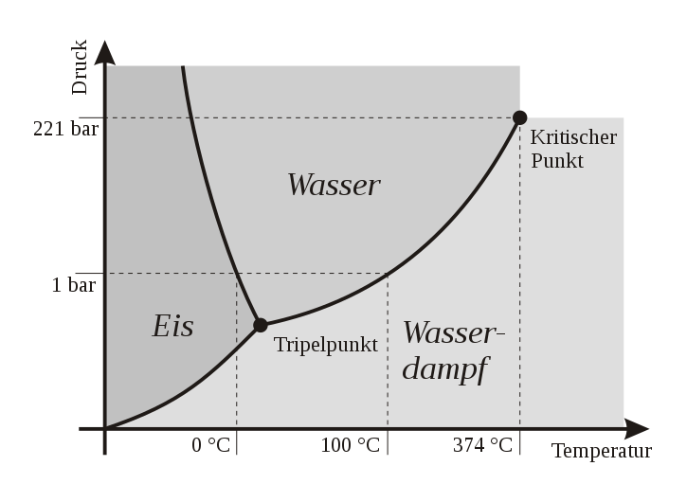
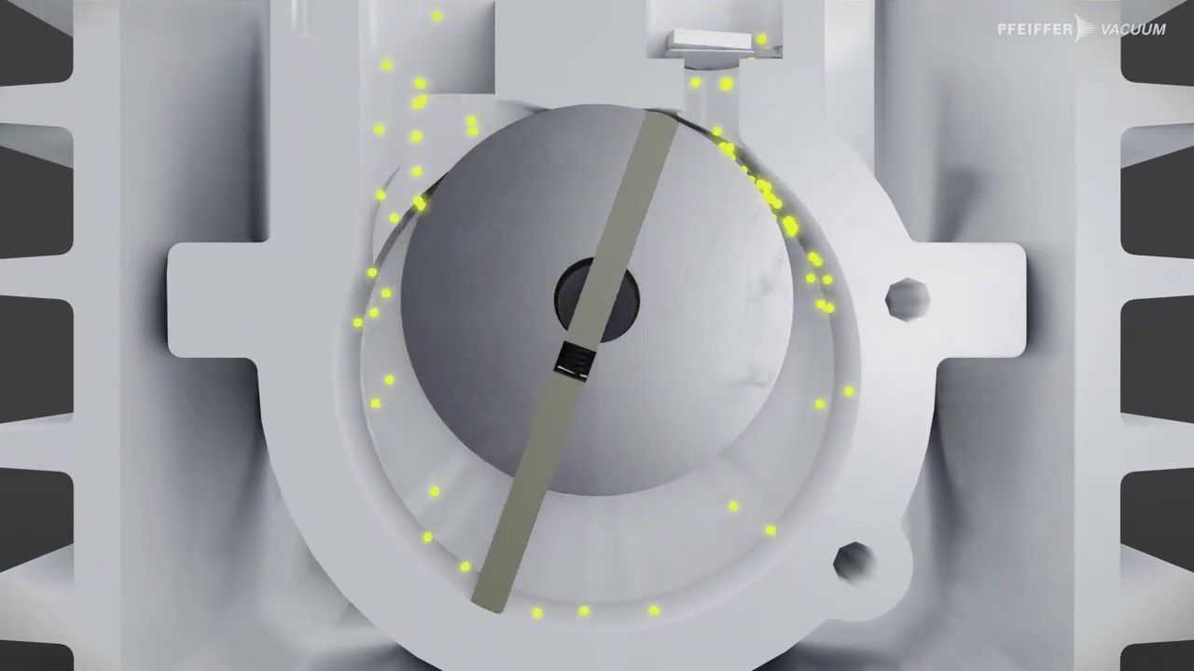
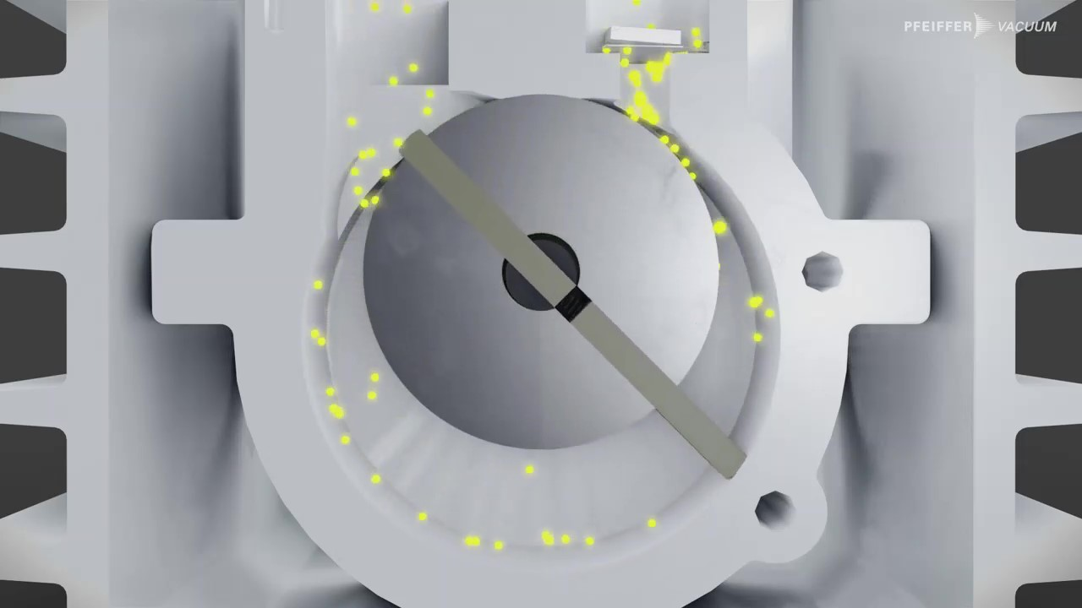
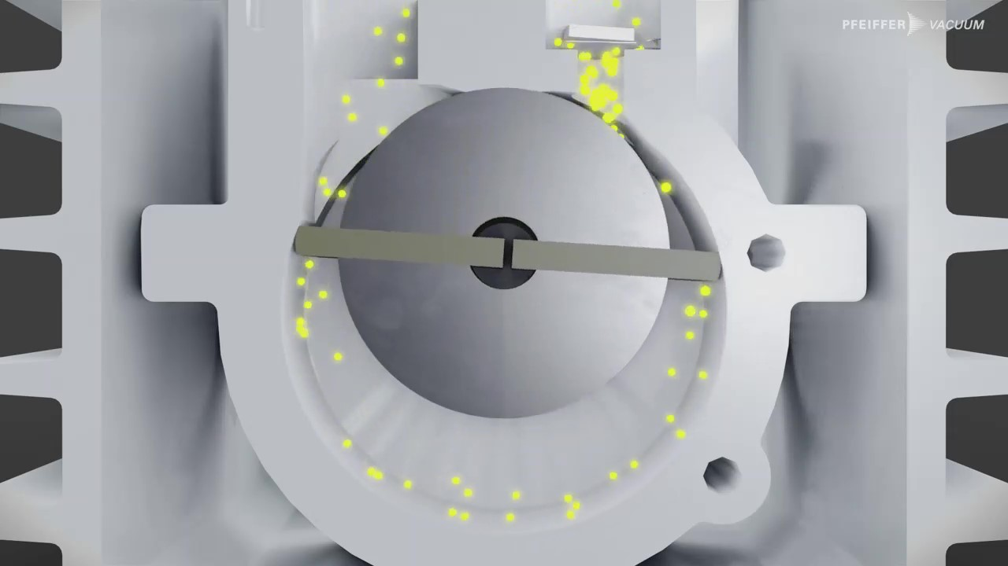
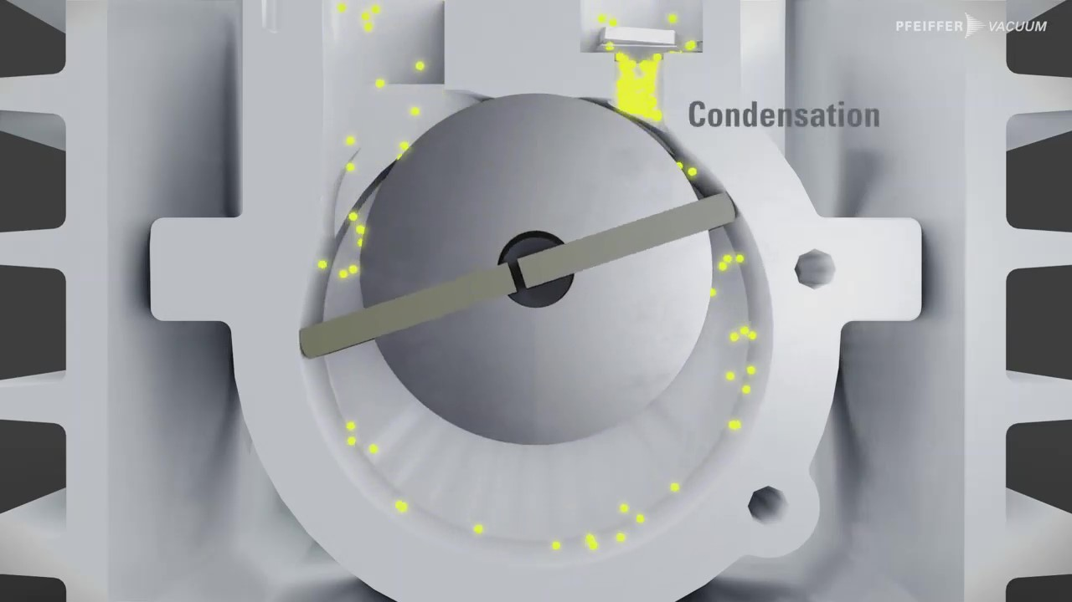
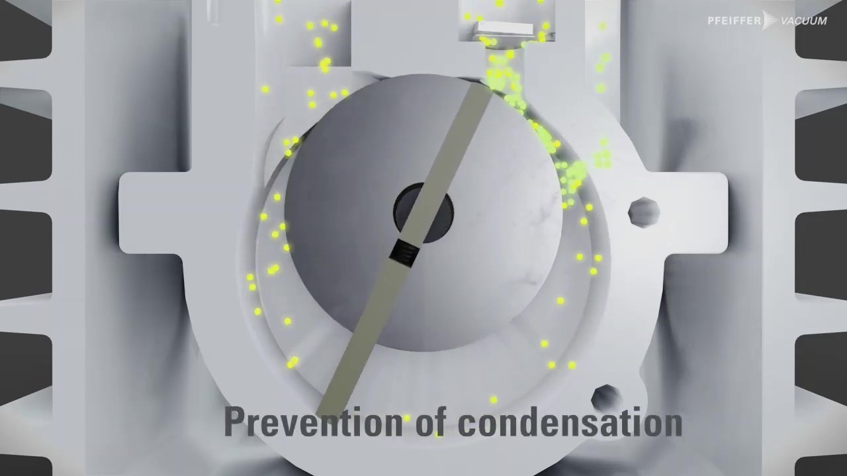
Rotary vane pump
Vacuum pumps
suction, closing, compression, ejection
Condensation ➔ gas ballast
p
water
1.3bar
ice
steam
T
Notes:
The chamber volume increases, and the gas gets sucked in
Rotating forward the chamber volume gets decreased again and the pressure increases
At the end of the compression phase the pressure is around 1.3 times the atmospheric pressure and the gas gets pressed out of the pump
In the part of the compression phase condensation can be a problem:
(The steam vaporizes again end reduces the final pressure of the pump)
KLICK
The temperature in the pump is between 60 and 90 degrees ➔ steam condensates before the outlet valve opens
Solutions:
Heating the pump
Or using a gas ballast: permanent adding of fresh air from the outside ➔ valve opens before the water condensates (why does it not condensates now: fraction of the water in the gas is smaller again: partial pressure of the steam is smaller than the saturation vapor pressure) (saturation vapor pressure of nitrogen is much higher)

Slide 9
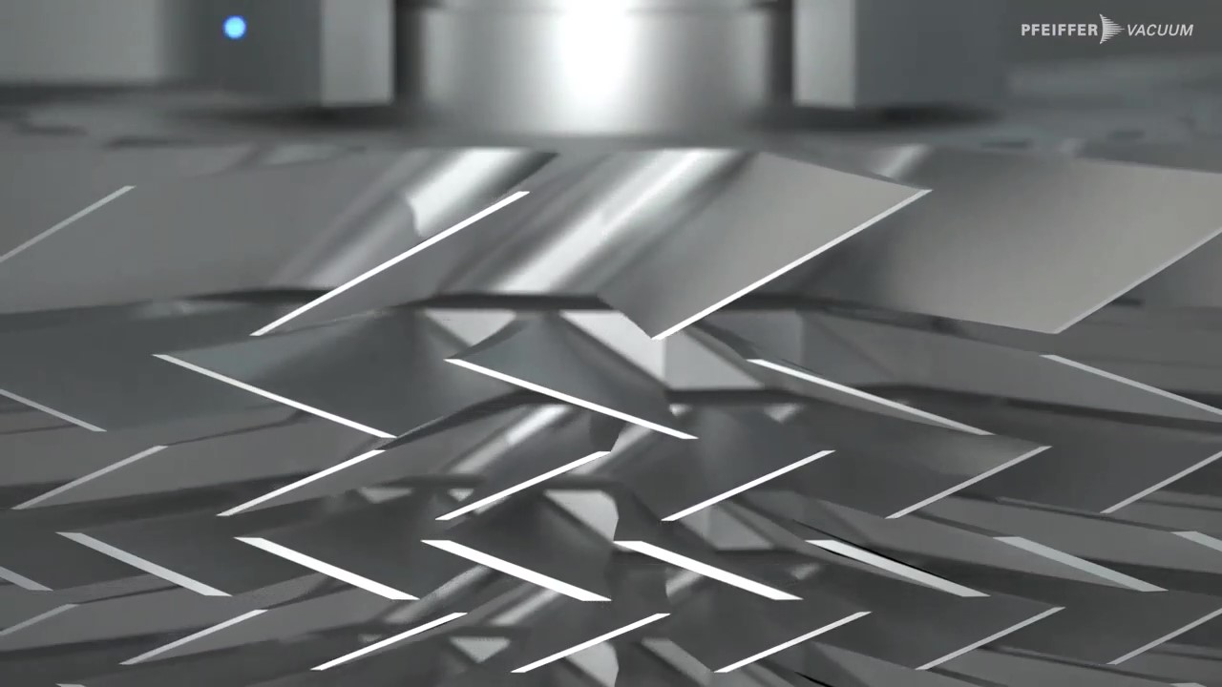
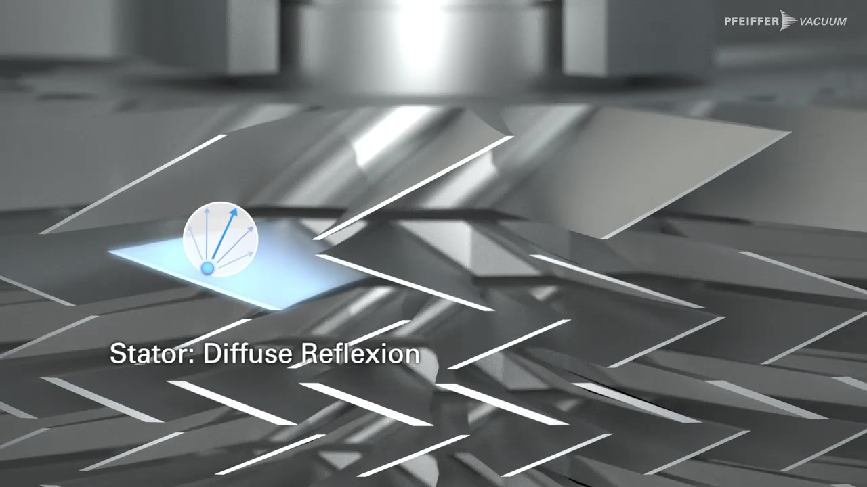
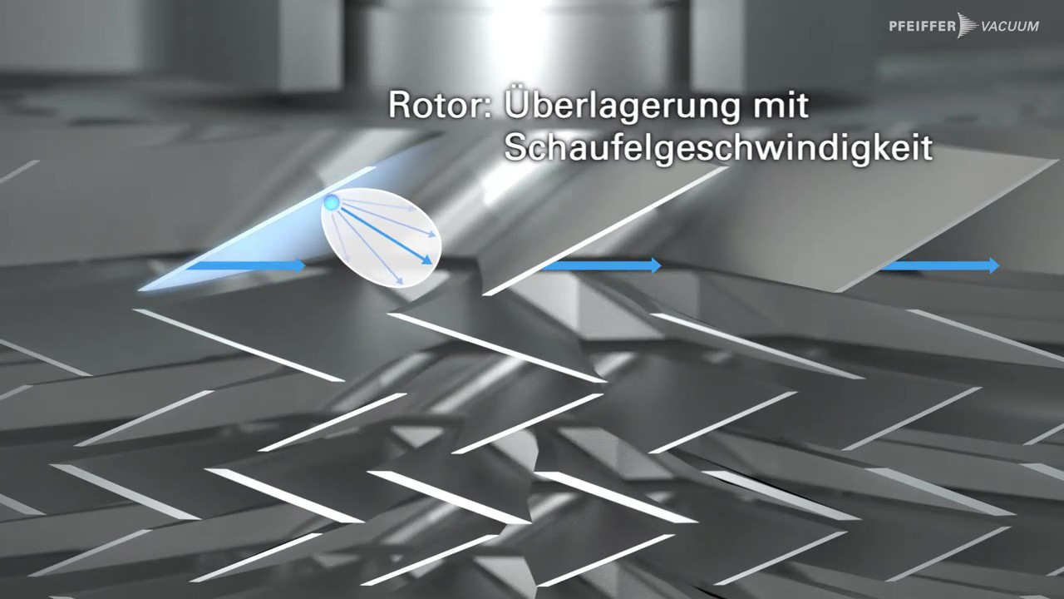
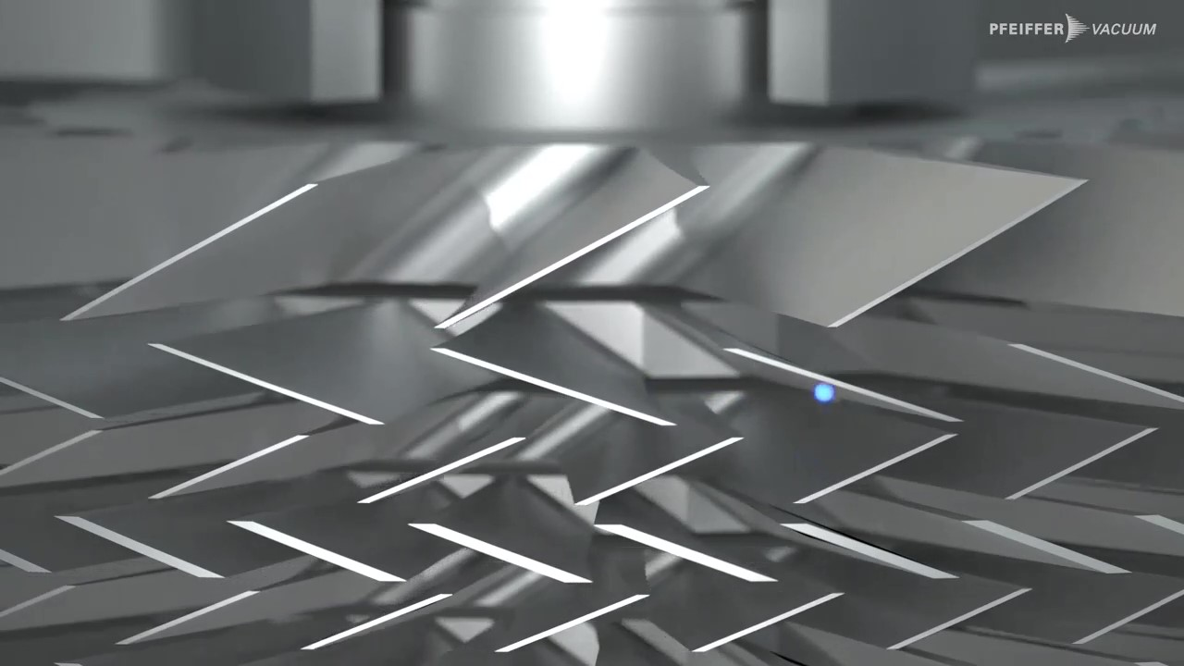
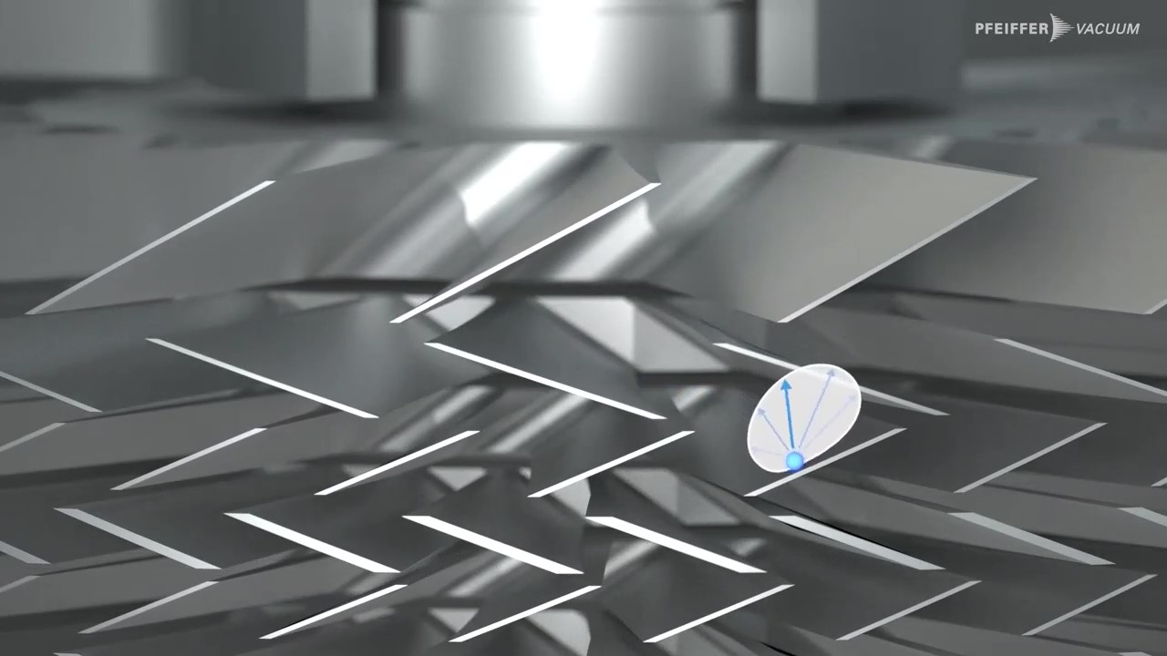
Turbo molecular pump (TMP)
Vacuum pumps
Ping-Pong-Principle
Backing pump is needed → 1mbar
static
static
Notes:
Rotor blades are rotating faster than the velocity of the molecules ➔ incoming molecules receive impulse towards the outlet (Ping-Pong-Principle)
KLICK → start video.
Reflection on a static blade
Moving rotor blade reflects the molecule to another moving rotor blade ➔ molecules move downwards like ping-pong-balls
Backing pump is needed → 1mbar, otherwise the pressure in the inside becomes too high and damages the pump + the pressure must be low, so that the average mean path is big enough so the impacts with the rotor blades are dominating
Final pressure is measured in the experimental part as well

Slide 10
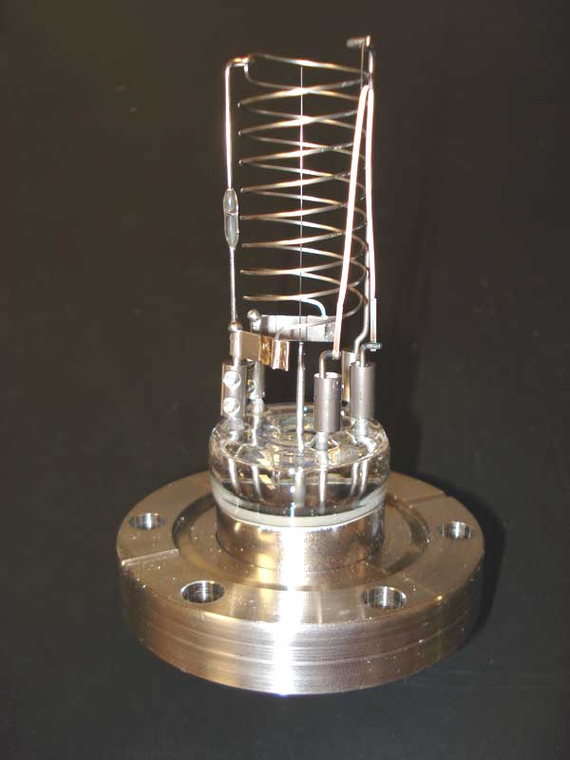
Vacuum gauges
Theoretical basics
Mechanical gauges
Pirani gauge
Cathode vacuum gauges
Hot Cathode vacuum gauge
ion
nitrogen
e-
e-
e-
e-
e-
e-
e-
Notes:
As the last part of the theorie I will give you a quick overview over some gauges [gayges]
Mechanical gauges:
A lot of different gauges
In principle all the same: the pressure causes a shift of deformation of a component in the gauge
Pirani gauge:
Uses that the specific thermal conductivity of a gas is pressure-dependent ➔ heat a wire inside the vacuum chamber and measure the lost power
Cathode vacuum gauges:
Generate an electric field in the inside of the vacuum chamber
Ionized molecules induce a discharge current which is proportional to the molecules left in the chamber
KLICK
In the TMP a hot cathode vacuum gauge is used
In the center: the hot cathode as electron source
Around a spiral, the Anode
And around this the negative charged collector
Between anode and cathode an acceleration voltage that accelerates the electrons
The electron ionizes the molecules
The collector catches the ionized molecules, and a current flow is measurable (which is directly proportional to the number of molecules left in the chamber)

Slide 11
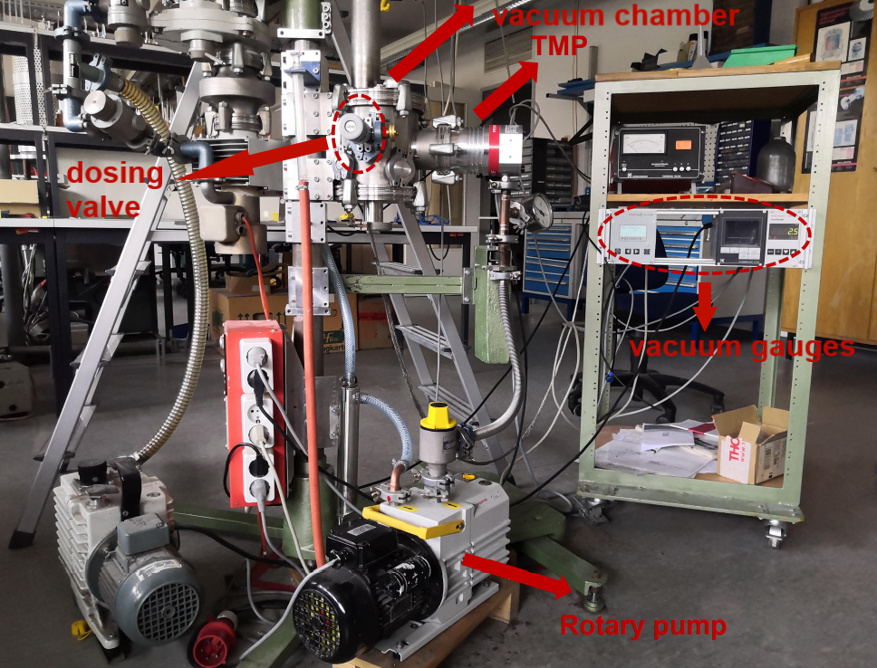
Overview of the setup
Experimental overview
vacuum chamber
TMP
dosing valve
Vacuum gauges
rotary pump

Slide 12
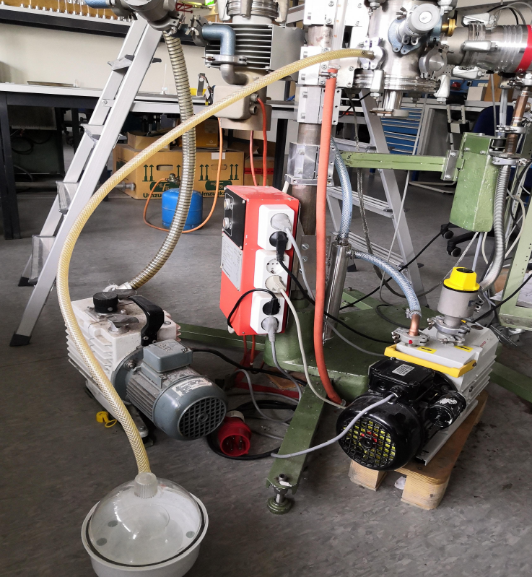
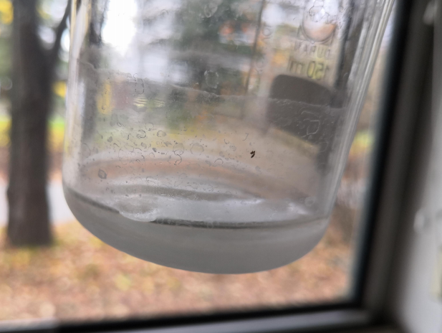
Pumping of condensable vapour
Experimental overview
Water inside recipient
Boiling, then freezing
Rotary pump with gas ballast

Slide 13
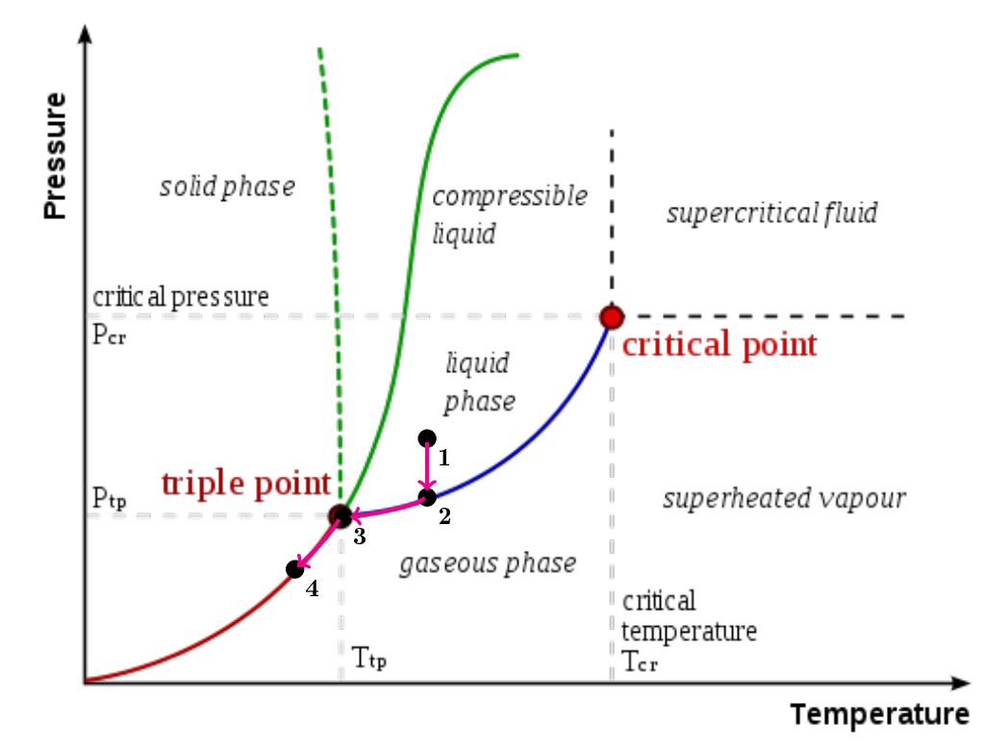
Pumping of condensable vapour
Experimental overview
1→2: | Pressure decrease
2→3: | evaporation
3→4: | Freezing and sublimation

Slide 14
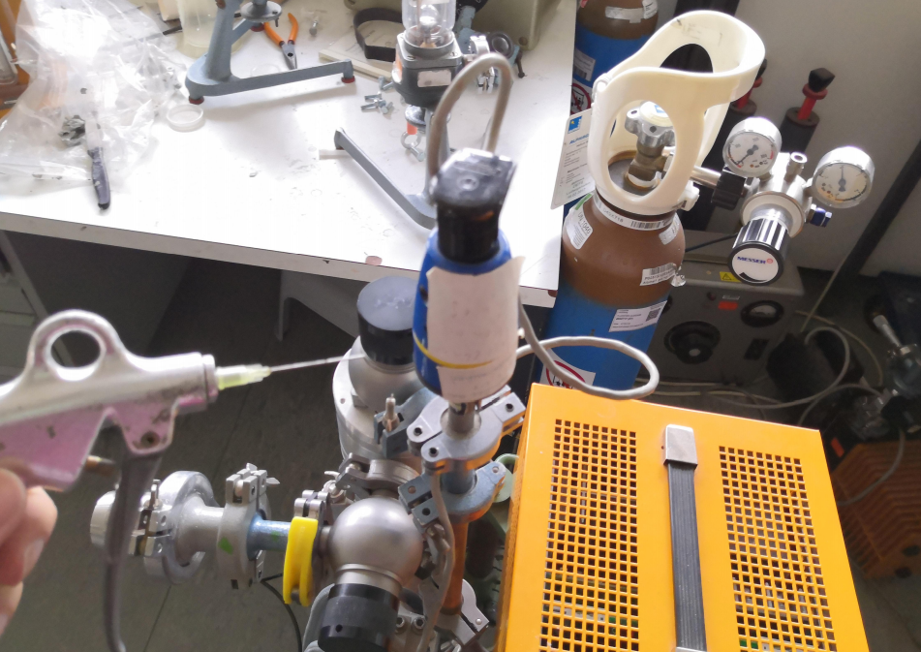
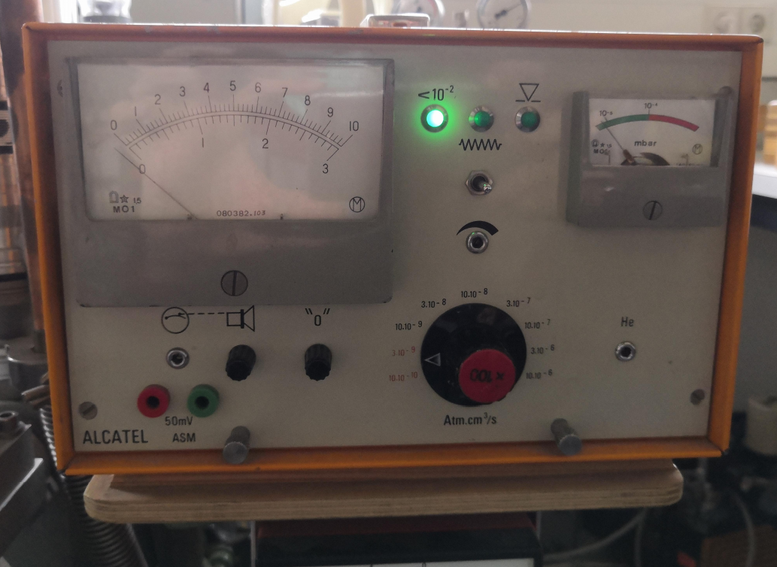
Leak detection
Experimental overview
helium spray to search for leaks
mass spectrometer inside -> „sniffler“

Slide 15
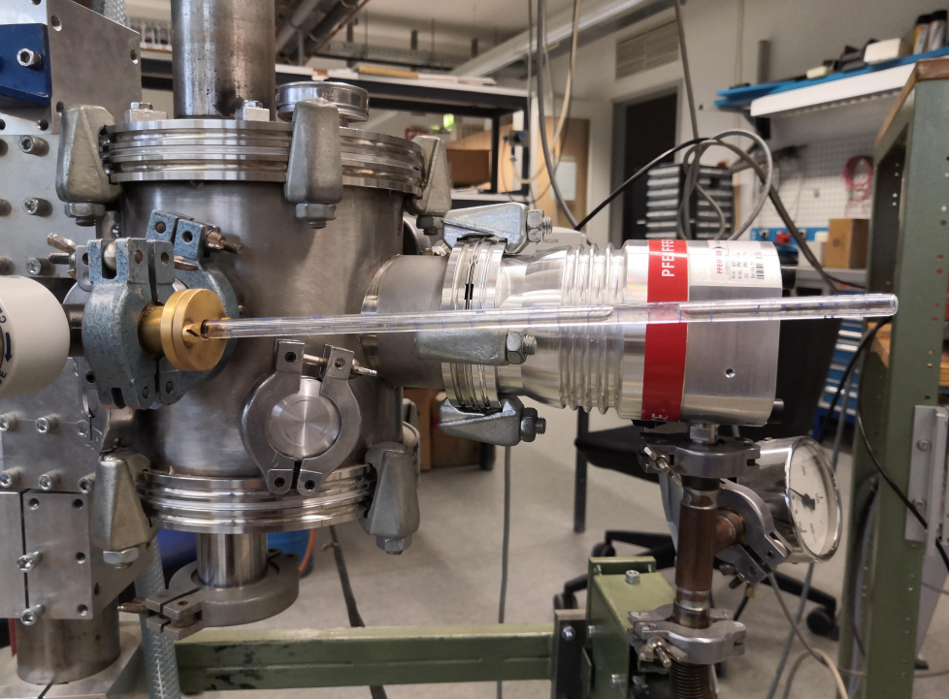
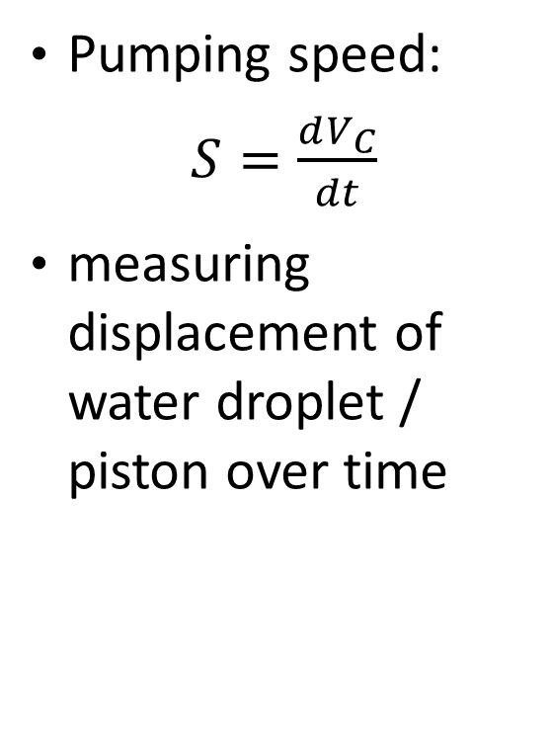
Pumping speed of the TMP
Experimental overview
Pumping speed:
$S=\frac{dV_{C}}{dt}$
measuring displacement of water droplet / piston over time
capillary with water drop

Slide 16
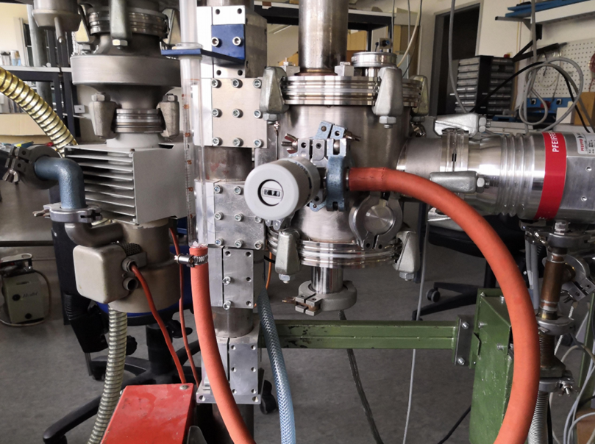
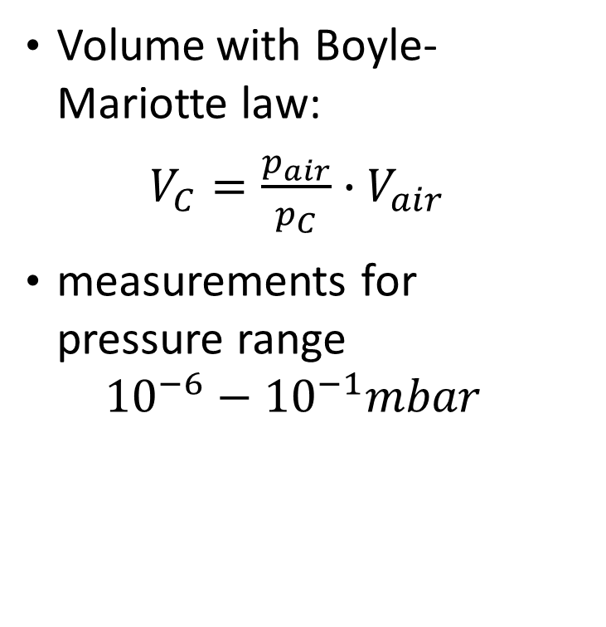
Pumping speed of the TMP
Experimental overview
Volume with Boyle-Mariotte law:
$V_{C}=\frac{p_{air}}{p_{C}}∙V_{air}$
measurements for pressure range ${10}^{−6}−{10}^{−1}mbar$
piston

Slide 17
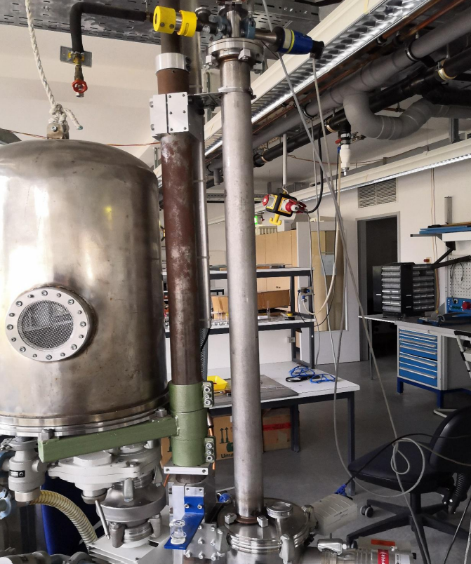
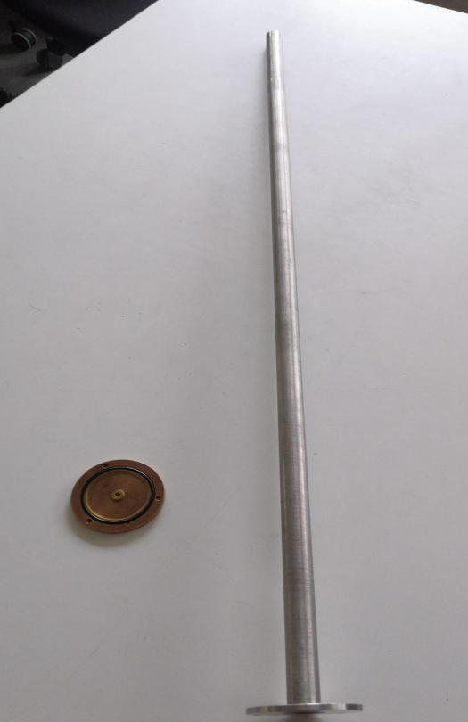
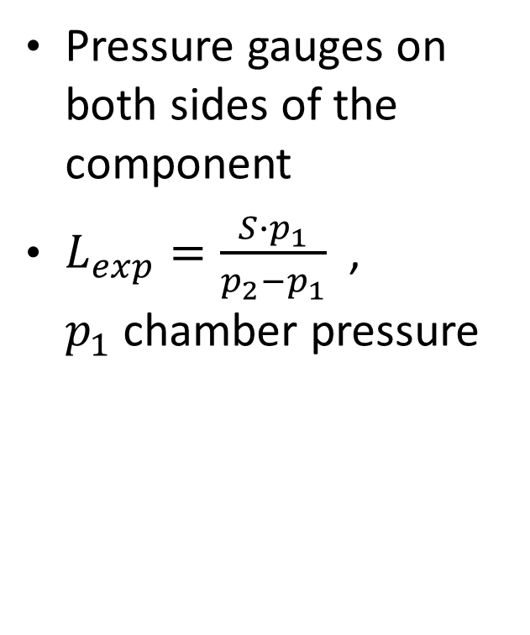
Conductance measurements
Experimental overview
Pressure gauges on both sides of the component
$L_{exp}=\frac{S∙p_{1}}{p_{2}−p_{1}}$, $p_{1}$chamber pressure
pipe
aperture

Slide 18
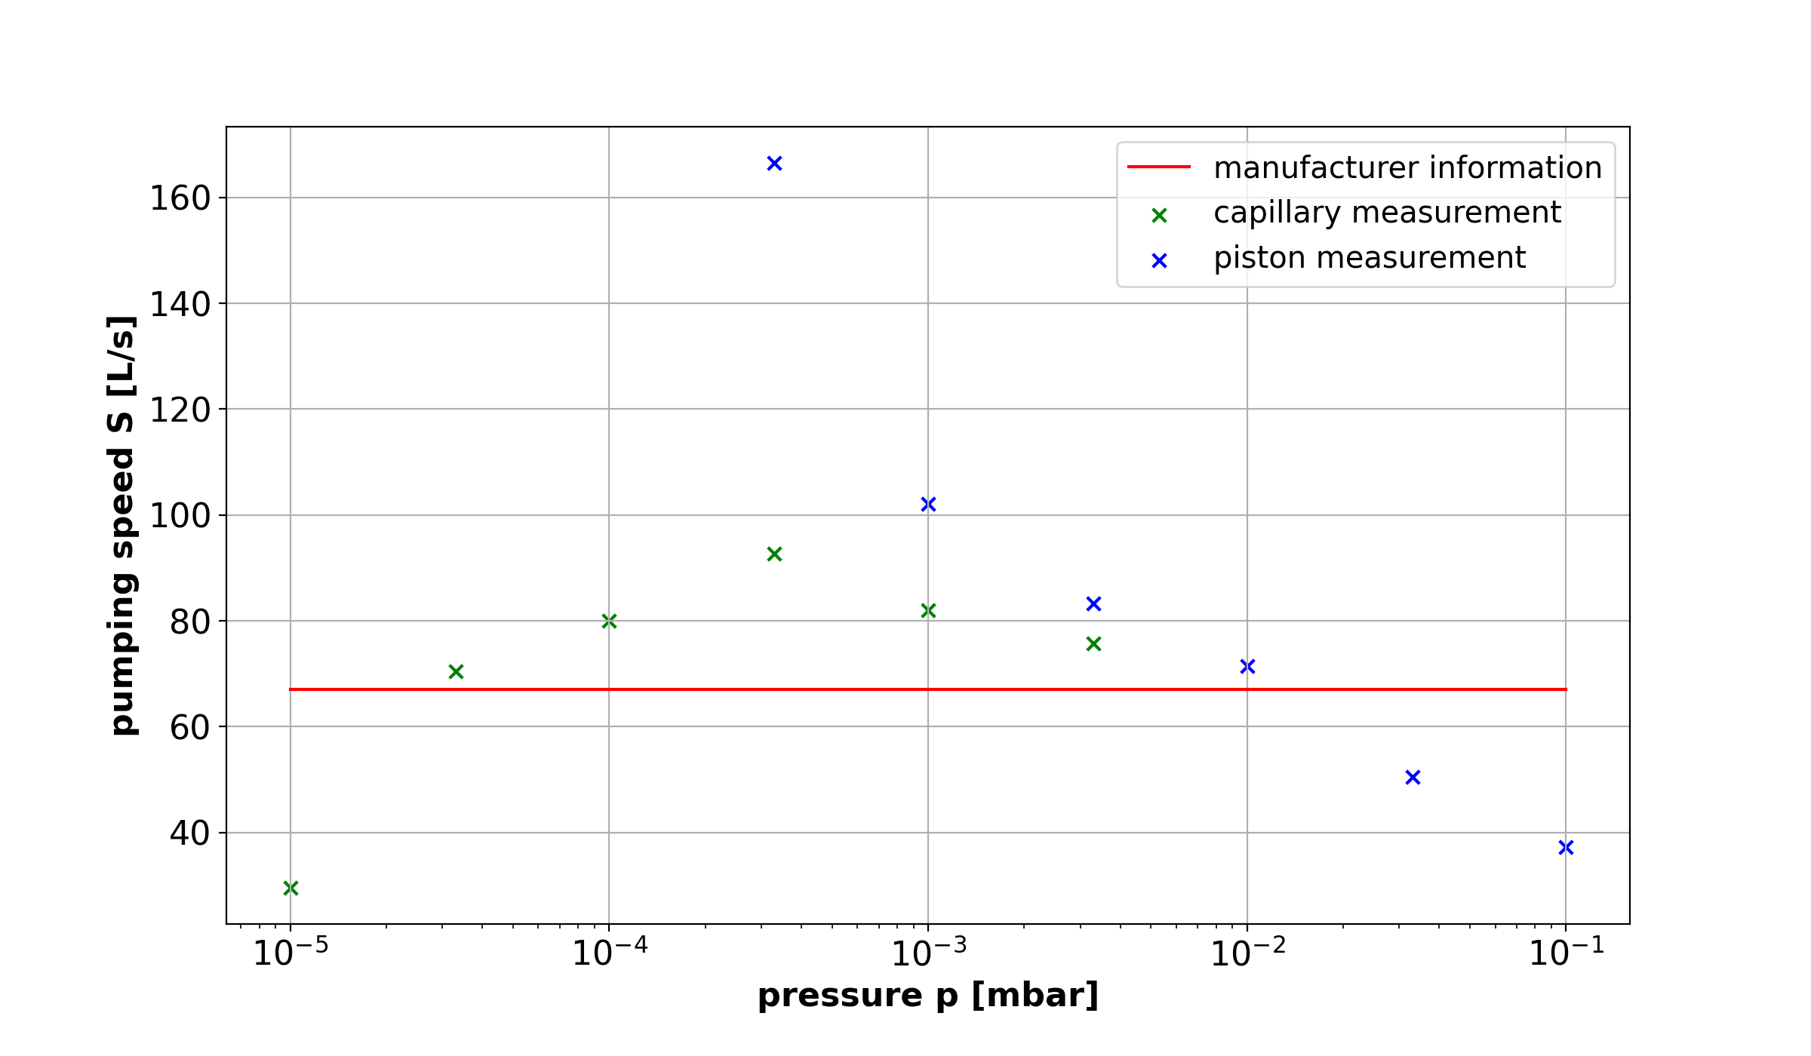
Pumping speed of the TMP
Evaluation
Notes:
Principle what one would expect:
KLICK -> middle section:
In the middle section the pumping speed is constant
But all experimental values are too high: so it seems like there is a systematic error systemic error?
Might come from the assumption that during the single measurements the pressure is constant
And from the Assumption that the temperature is const. so we can easily transfer the volume
KLICK -> left flank:
Explainable with pseudo leaks
Gases are leaking out of the recipient walls ➔ thus, the pump pumps the real volume + the gas from the pseudo leaks
KLICK -> right flank:
Explainable with average free path length:
The rotor blades are giving the molecules impulses towards the outlet
Higher pressure means more molecules, so there are more collisions between the molecules and the transmitted impulse of the rotor blades get lost

Slide 19
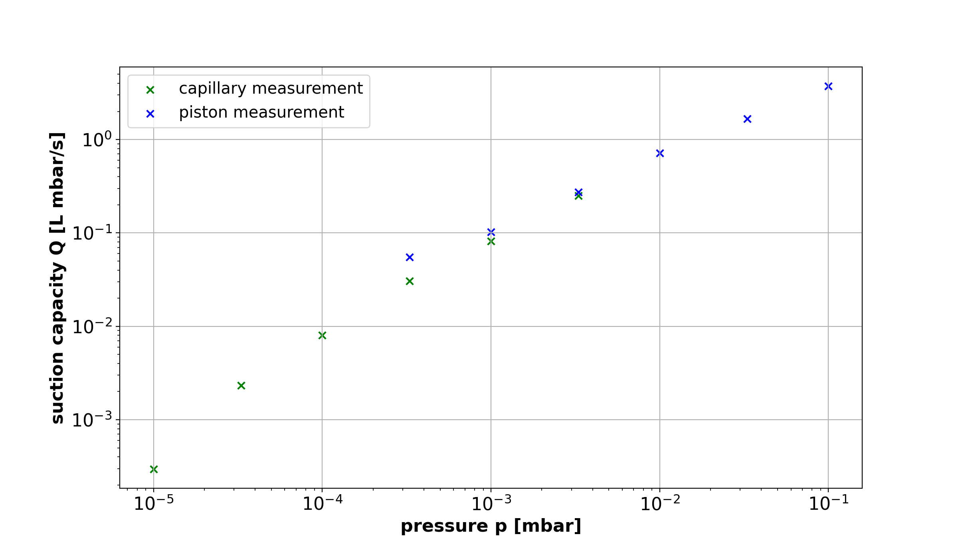
Suction capacity of the TMP
Evaluation
Notes:
Like expected:
Suction capacity is the pumped volume times the pressure, so for low pressures the suction capacity reduces

Slide 20
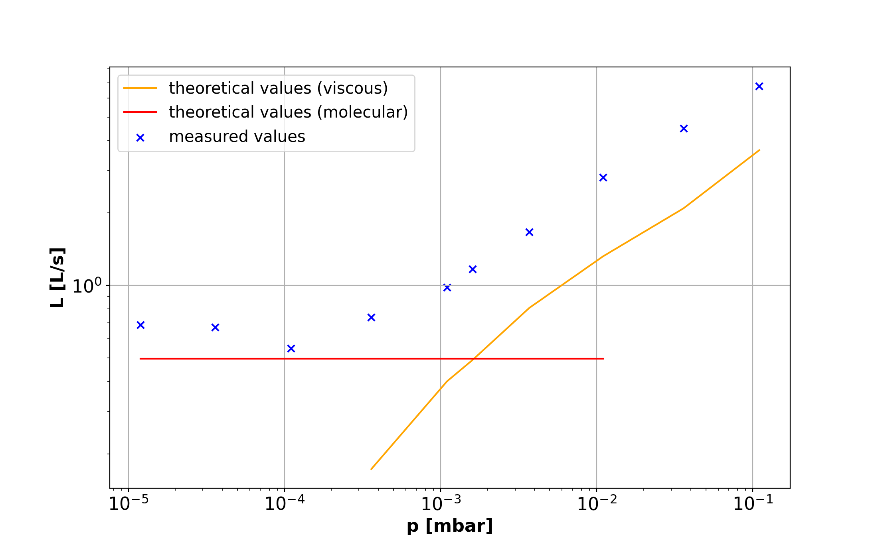
Conductance of the tube
Evaluation
Notes:
In principle what we is expected in the theory:
For small pressures, the conductance is constant and follows the molecular formula
For high pressures, the experimental data has the development of the viscous flow
BUT overall, all data points differ upwards. It seems like here is a systematic error.
This error can come from errors in the pressure measurement in the case of the continues flow
In the molecular case the temperature of the gas is needed, and we did not have one
We already have an error in the measurement of the pumping speed (and L_exp is proportional to S)

Slide 21
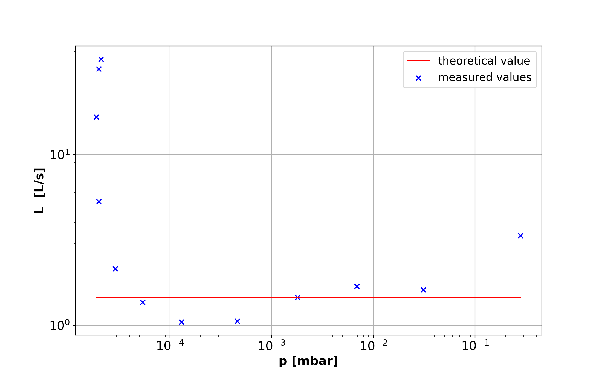
Conductance of the aperture
Evaluation
Notes:
In the range between 10E-4 to 10E-1 is a good agreement between the theoretical value and the measured data points
The steep flank on the left is explainable with pseudo leaks again:
It seems like there is more volume pumped and the conductance increases

Slide 22
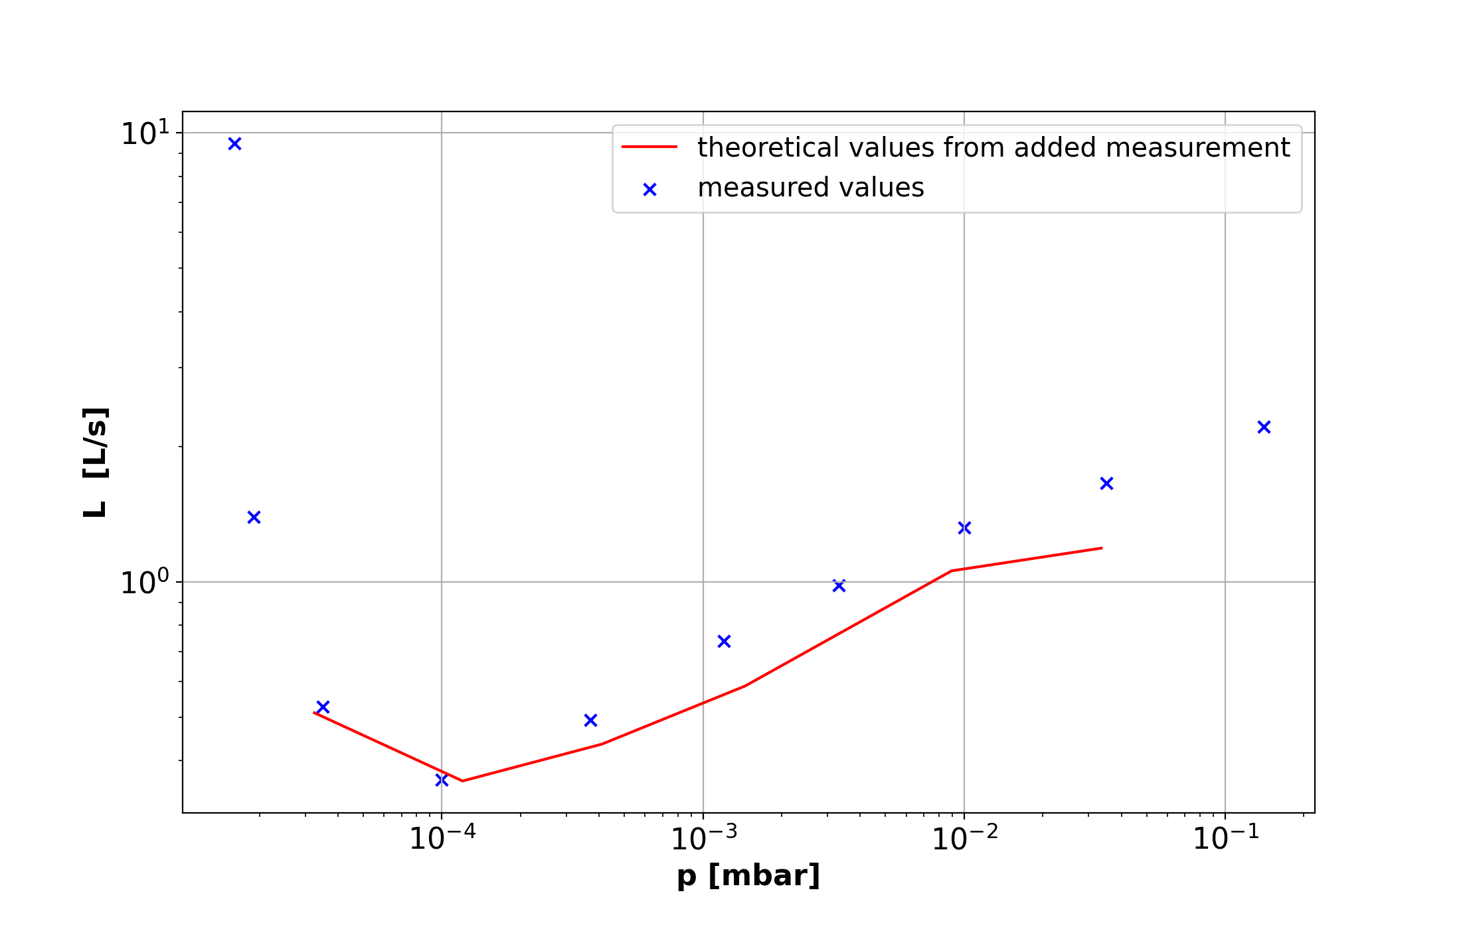
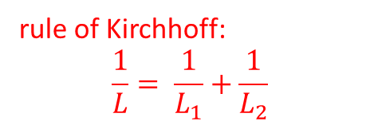
Conductance of series connection
Evaluation
rule of Kirchhoff:
$$\frac{1}{L}= \frac{1}{L_{1}}+\frac{1}{L_{2}}$$
Notes:
On the left and right edges, we do not have theoretical values, as the pressures of the single measurements do not match#
In the middle one can see that the experimental values agree with the theoretical values very good

Slide 23
Discussion
no error estimates in the data set
more qualitative than quantitative experiment
Reaction times, leaks, temperature changes,…
conductance measurements difficult to compare, because of different pressure values
good overview of basic vacuum technology
Practical component of for example leak detection missing
if possible, wait for end of restrictions

Slide 24
For the future
Vacuum components should maximize the cross-section areas
For the pumping of condensable vapor, a gas ballast is needed
Vacuum components can be described analogous to electrical circuit
different final pressures different pumps

Slide 25
Sources
Karl Jousten. Handbuch Vakuumtechnik. Springer, 2018
Dieter Meschede. Gerthsen Physik. Springer, 2010
https://commons.wikimedia.org/wiki/File:Image_Phase-diag2.svg
https://en.wikipedia.org/wiki/Hot-filament_ionization_gauge#/media/File:Bayard-Alpert_gauge.jpg
https://www.youtube.com/watch?v=f1SErZyhMe4
https://www.youtube.com/watch?v=R-Rz_Tegq8E

Slide 26
Thank you for your attention!

Slide 27
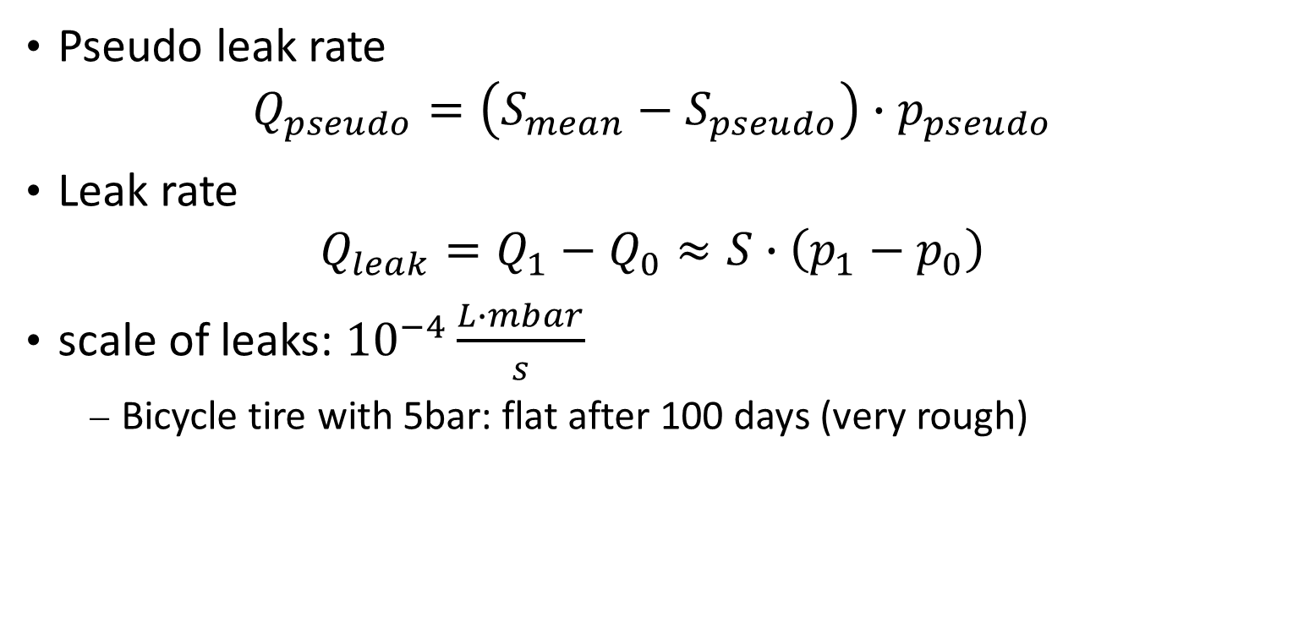
Additional
Pseudo leak rate $Q_{pseudo}=\left(S_{mean}−S_{pseudo}\right)∙p_{pseudo}$
Leak rate $Q_{leak}=Q_{1}−Q_{0}≈S∙\left(p_{1}−p_{0}\right)$
scale of leaks: ${10}^{−4}\frac{L∙mbar}{s}$
Bicycle tire with 5bar: flat after 100 days (very rough)

